Slide 1
Loan Calculator Example
Purpose:
To practice combining your Java class building and GUI development skills.

Slide 2
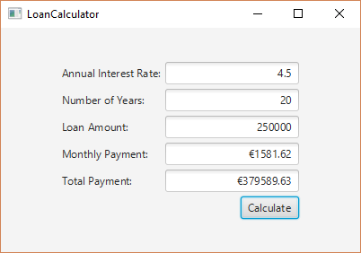
Introduction
We will work towards an application that looks like this:

Slide 3
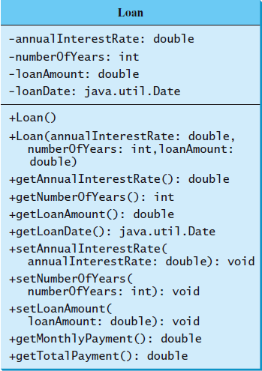
Step 1
Write a Loan.java class according to the following UML class diagram:

Slide 4
Step 1 – The Loan class
For the getMonthlyPayment() method you can use the following:
/** Find monthly payment */
public double getMonthlyPayment()
{
double monthlyInterestRate = annualInterestRate / 1200;
double monthlyPayment = loanAmount * monthlyInterestRate
/ (1 - (1 / Math.pow(1 + monthlyInterestRate, numberOfYears * 12)));
return monthlyPayment;
}
Total cost of the loan will simply be
getMonthlyPayment() * numberOfYears * 12;

Slide 5
Step 2 – Test the Loan class
Write a simple test driver to test the Loan class.
Request some inputs from the user
annualInterestRate,
numberOfYears,
loanAmount
Create a Loan object
Loan loan = new Loan(annualInterestRate,
numberOfYears, loanAmount);
Print out the return values from
loan.getMonthlyPayment();
loan.getTotalPayment();

Slide 6
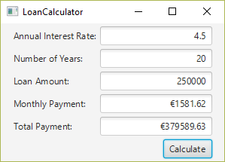
Step 3 – Design the GUI
Our screen will have TextField nodes
(boxes into which we can type text)
The Monthly Payment and Total Payment fields
are display-only (the user can’t type In these)

Slide 7
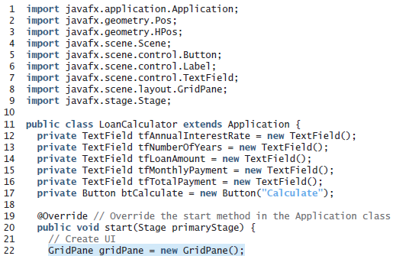
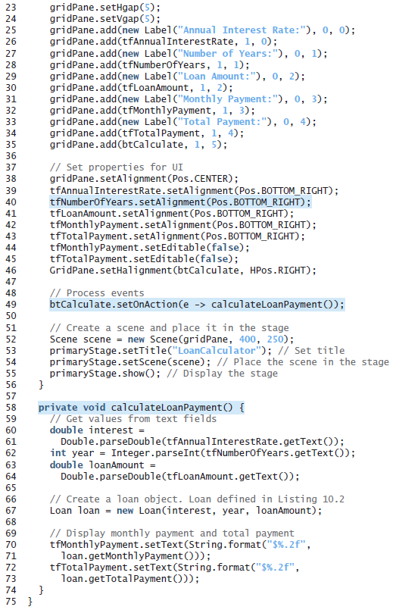
Step 4 – Code the GUI
Eighty-five lines of code simply isn’t readable at this size, so we’ll go through this program in pieces
// Process events
btCalculate.setOnAction(new CalcHandlerClass());

Slide 8
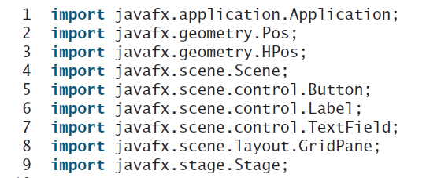
Step 4 – Code the GUI
Lines 1 – 9 simply import the JavaFX components we will need for this program
// Process events
btCalculate.setOnAction(new CalcHandlerClass());

Slide 9
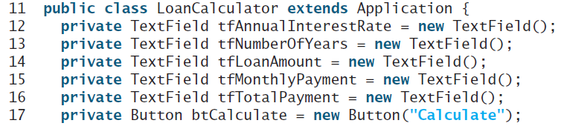
Step 4 – Code the GUI
Lines 11 – 17 begin our LoanCalculator class (an extension of Application), and create the five TextFields (and the “Calculate” Button) as fields of the class
These are set up as fields so that the method to do the calculation (see below) can see them, and we don’t have to pass them all as parameters (by making them fields, they have class-wide scope)
// Process events
btCalculate.setOnAction(new CalcHandlerClass());

Slide 10

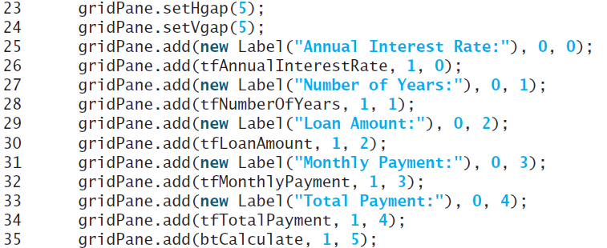
Step 4 – Code the GUI
Line 20 begins our code, with an override of start
Lines 22 – 35 set up a 5-x-2 GridPane, with Labels (left side) and TextFields (right side) for the first 4 rows
The 5th row holds only the “Calculate” Button, right-justified in the right column (nothing in the left column)
// Proces events
btCalculate.setOnAction(new CalcHandlerClass());

Slide 11
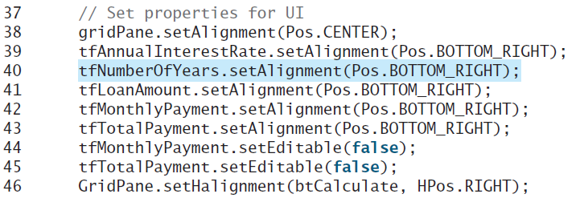
Step 4 – Code the GUI
Line 38 centers the GridPane in its Scene
Lines 39 – 43 cause the text in the TextFields to be right-justified within the fields
Lines 44 – 45 keep the user from being able to edit (type inside of) those two TextFields (we’re going to calculate their values and fill them in via code; the user shouldn’t be able to enter anything in them)
Line 46 right-aligns the “Calculate” Button in its grid cell
// Process events
btCalculate.setOnAction(new CalcHandlerClass());

Slide 12

Step 4 – Code the GUI
Line 49 creates a new handler object (from the inner class CalcHandlerClass which we can’t see on the left but shown below) and registers it to the “Calculate” Button. Our overridden handle method contains a single line of code – a call to the calculateLoanPayment method.
class CalcHandlerClass implements EventHandler<ActionEvent> {
@Override
public void handle(ActionEvent e) {
calculateLoanPayment();
}
}
// Process events
btCalculate.setOnAction(new CalcHandlerClass());

Slide 13
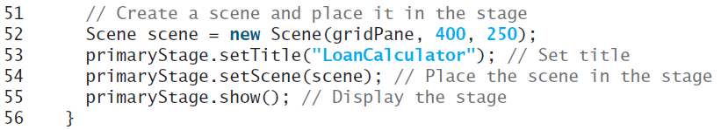
Step 4 – Code the GUI
Lines 51 – 56 form the typical end of the start method:
The container for our UI elements (the GridPane) is added to a new Scene (line 52), which is added to the Stage (line 54).
The Stage is given a title (line 53), and made visible (line 55)
// Process events
btCalculate.setOnAction(new CalcHandlerClass());

Slide 14
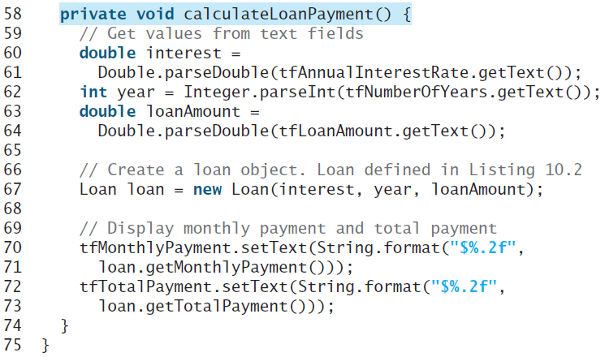
Step 4 – Code the GUI
In order to do the calculations, we need the values to be in numeric variables, but the TextField boxes all hold Strings, so we have to parse them into numeric variables first (lines 60-64)
// Process events
btCalculate.setOnAction(new CalcHandlerClass());

Slide 15
Step 4 – Code the GUI
Once we have the numeric versions of the Strings in the three TextFields, we can use those to create a Loan object.
Once instantiated, the Loan class provides the methods getMonthlyPayment() and getTotalPayment() to give us the values to display in the last two TextFields (lines 70 – 73).
// Process events
btCalculate.setOnAction(new CalcHandlerClass());

